Slide 1
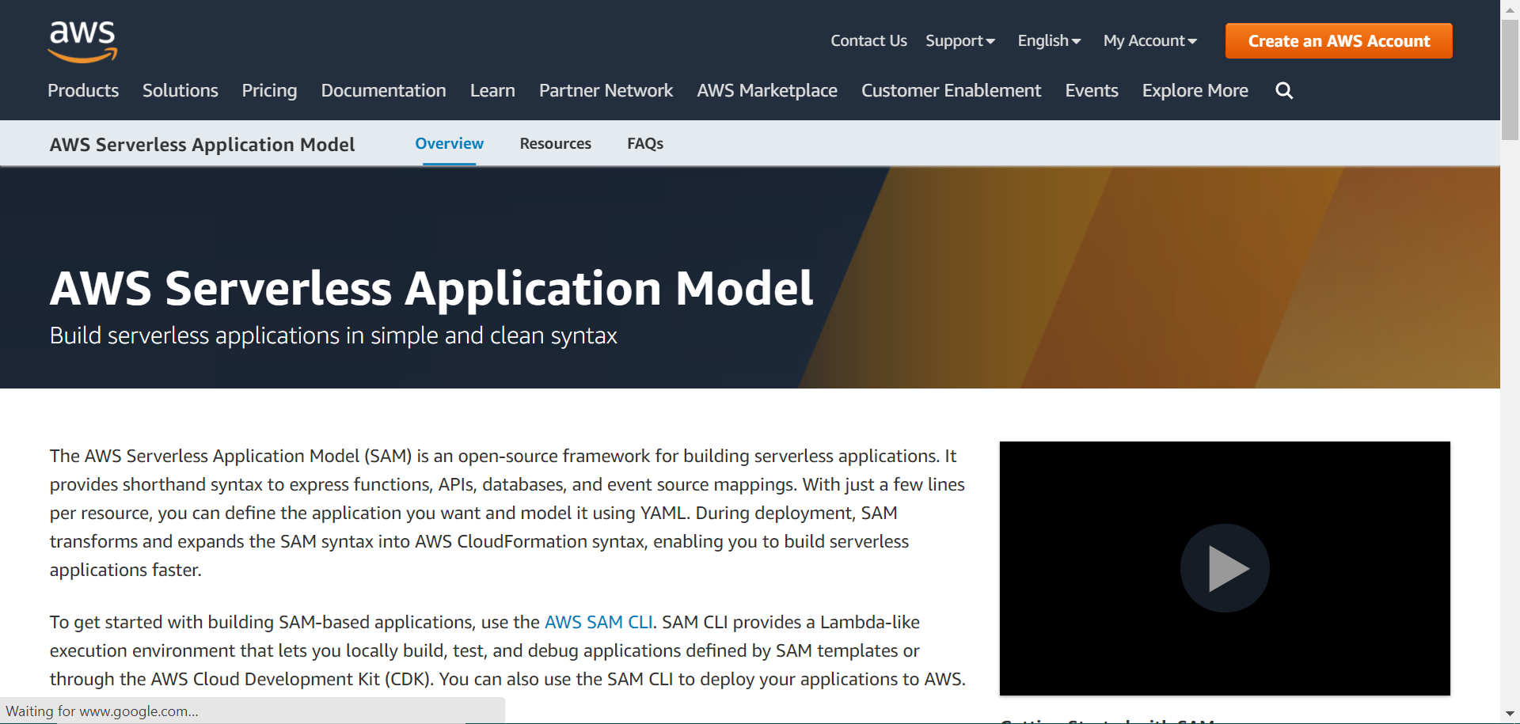
Notes:
https://aws.amazon.com/serverless/sam/

Slide 2
